Slide 1

NSG Pilkington – University of Liverpool Machine Learning Project: 14/10/2020
Dr. Peter Green
Diego Echeverria
Risk Institute,
School of Engineering

Slide 2
List of activities
Ongoing work looking at filtering of inputs.
To run the autoregressive approach 1 with inputs removed.
To run the autoregressive approach 2.
Re-run randomly selected inputs, focusing on 2nd half of data.
Better visualisation of effect of inputs on model output.

Slide 3
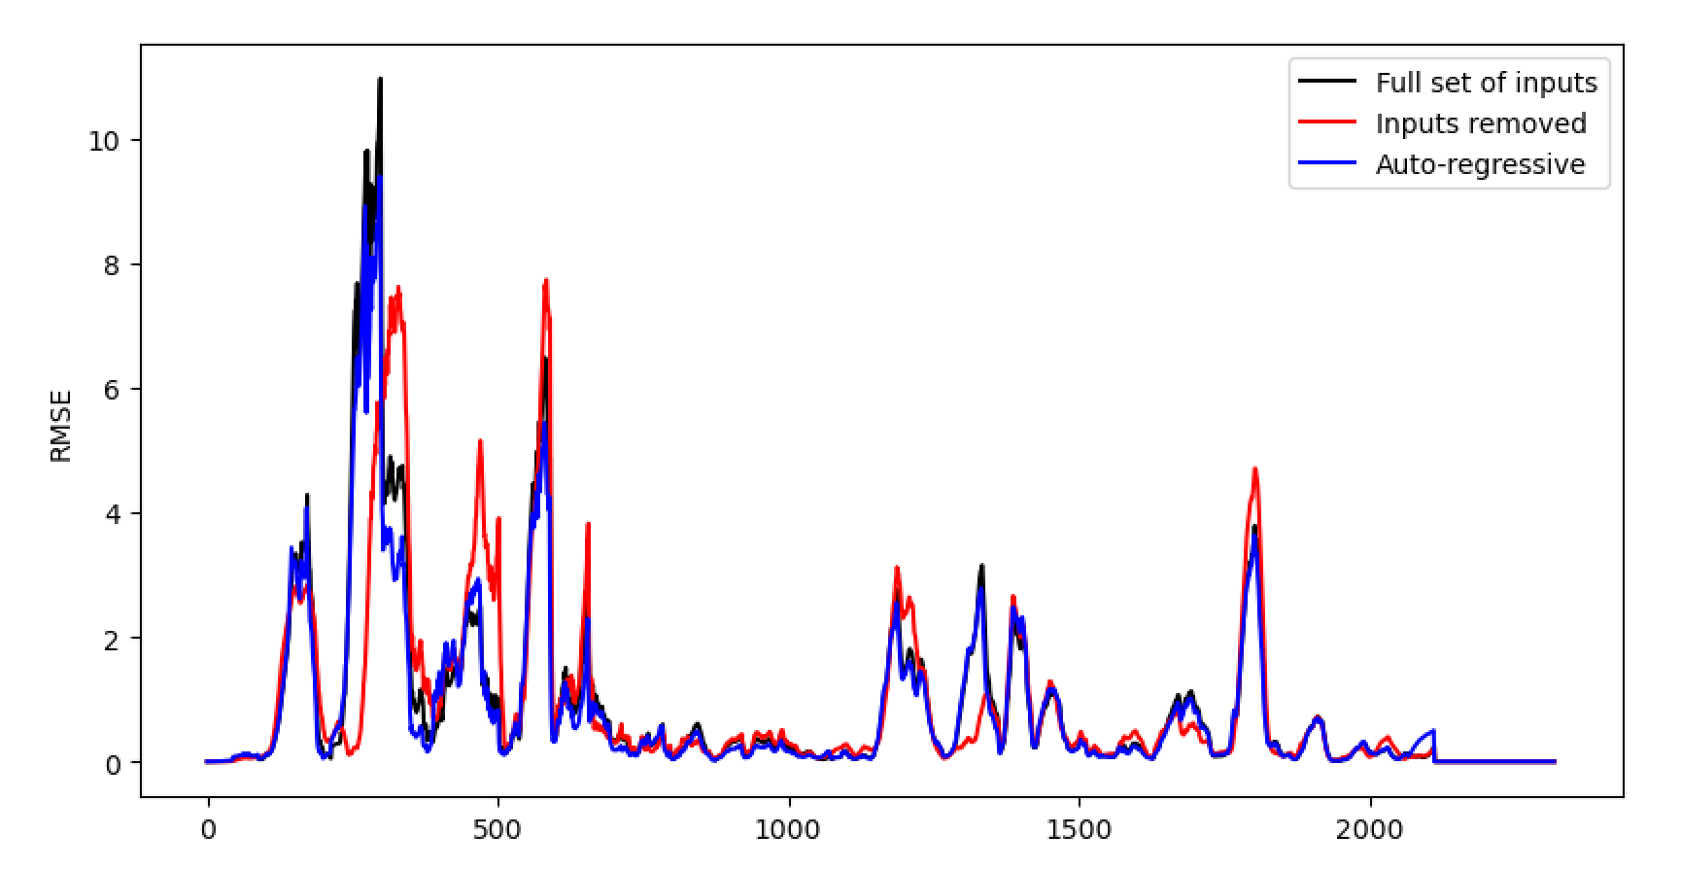
Summary of last week’s results:

Slide 4
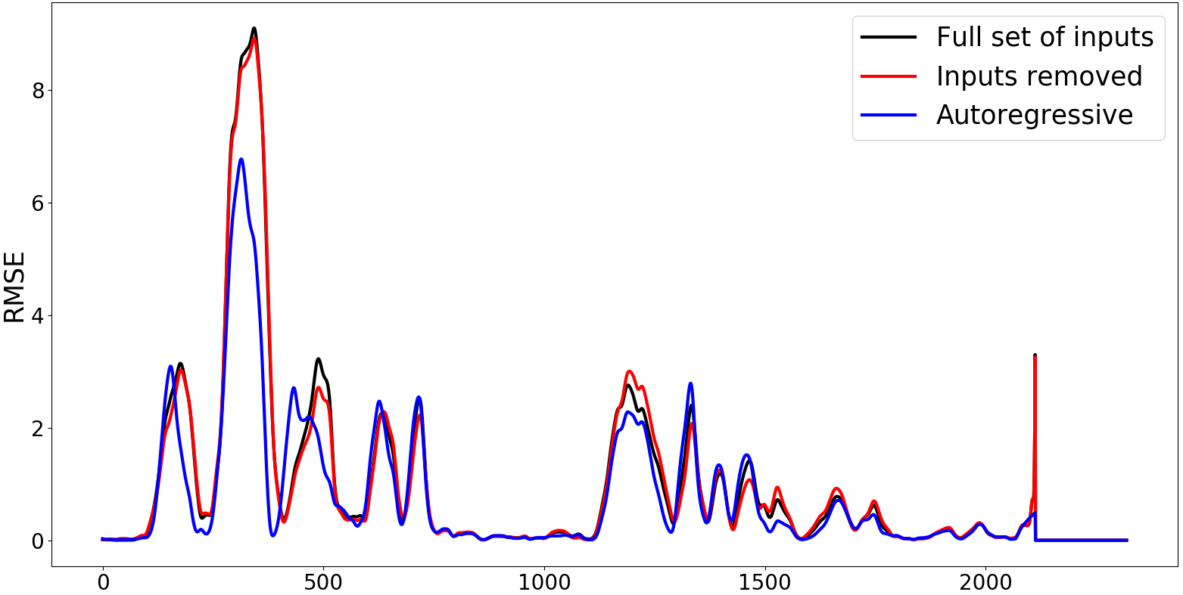
We have varied the parameters of the input filters which have resulted in smoother inputs and better predictions.

Slide 5
List of activities
Ongoing work looking at filtering of inputs.
To run the autoregressive approach 1 with inputs removed.
To run the autoregressive approach 2.
Re-run randomly selected inputs, focusing on 2nd half of data.
Better visualisation of effect of inputs on model output.

Slide 6
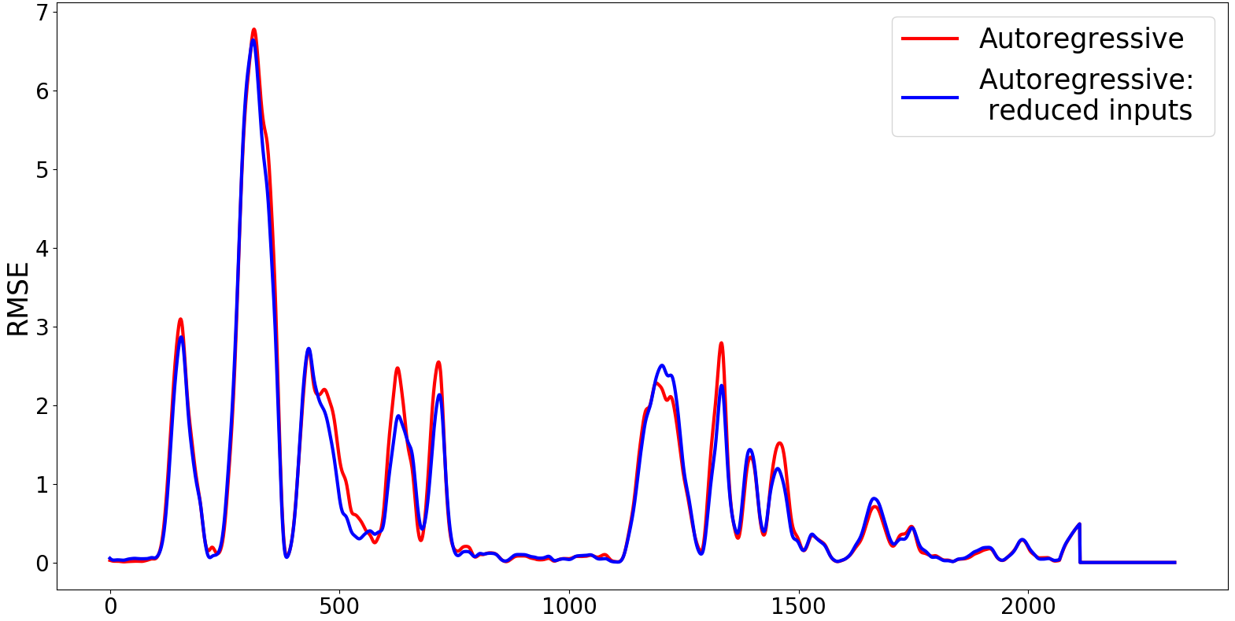
Autoregressive approach (1) with inputs removed

Slide 7
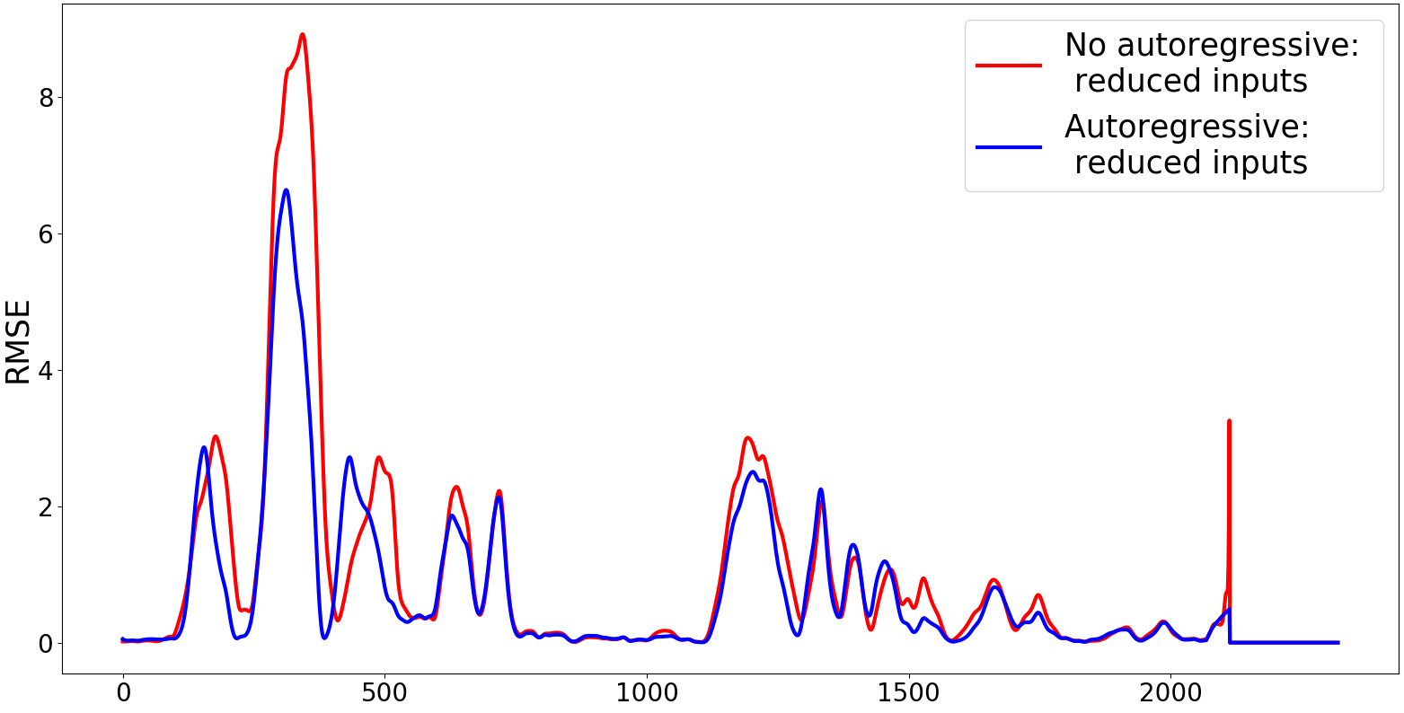
Autoregressive approach (1) with inputs removed

Slide 8
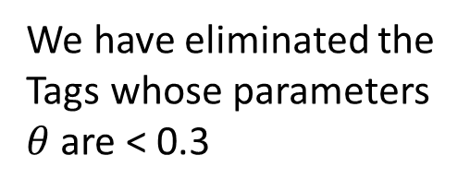
Inputs that were retained (Autoregressive (1)):
10278 Canal Temp. Control (OP)
7474 Lehr Drive Line Shaft Speed
10425 Calculated Cullet Ratio
11105 Port 1 Combustion Air Flow LHS (OP)
11132 Port 8 Combustion Air Flow RHS (OP)
9282 Tweel Position
11201 Furnace & Services Pack Sub S8 L.H. Section - HV13
9393 Glass Level Control (OP)
11209 MV49
9395 Main Gas Pressure (OP)
135 Total Firm Gas Flow Measurement
136 Total Combustion Air Flow Measurement
1650 Combustion Air Temperature Measurement
239 Working End Burner Gas Flow RHS (PV)
30208 Feeder Speed Measurement Left
6400 Furnace Compressed Air Flow Measurement
6469 Furnace Pressure Meas. on Crown
6472 Front Wall Temperature 7
We have eliminated the Tags whose parameters $θ$ are < 0.3

Slide 9
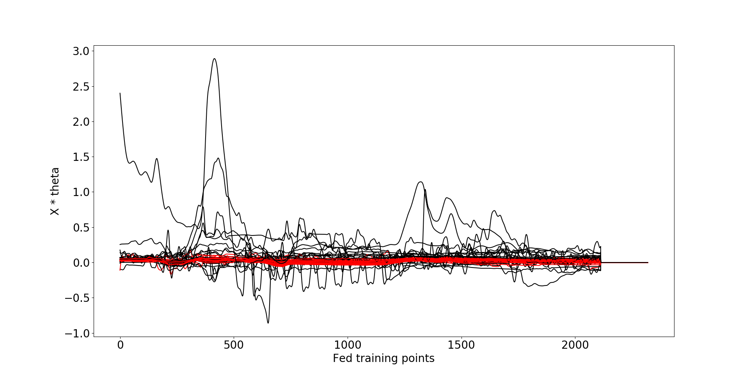
Eliminated:
10278 Canal Temp. Control (OP)
7474 Lehr Drive Line Shaft Speed
10425 Calculated Cullet Ratio
11105 Port 1 Combustion Air Flow LHS (OP)
11132 Port 8 Combustion Air Flow RHS (OP)
9282 Tweel Position
11201 Furnace & Services Pack Sub S8 L.H. Section - HV13
9393 Glass Level Control (OP)
11209 MV49
9395 Main Gas Pressure (OP)
135 Total Firm Gas Flow Measurement
136 Total Combustion Air Flow Measurement
1650 Combustion Air Temperature Measurement
239 Working End Burner Gas Flow RHS (PV)
30208 Feeder Speed Measurement Left
6400 Furnace Compressed Air Flow Measurement
6469 Furnace Pressure Meas. on Crown
6472 Front Wall Temperature 7
Autoregressive approach (1) with reduced inputs

Slide 10
List of activities
Ongoing work looking at filtering of inputs.
To run the autoregressive approach 1 with inputs removed.
To run the autoregressive approach 2.
Re-run randomly selected inputs, focusing on 2nd half of data.
Better visualisation of effect of inputs on model output.

Slide 11
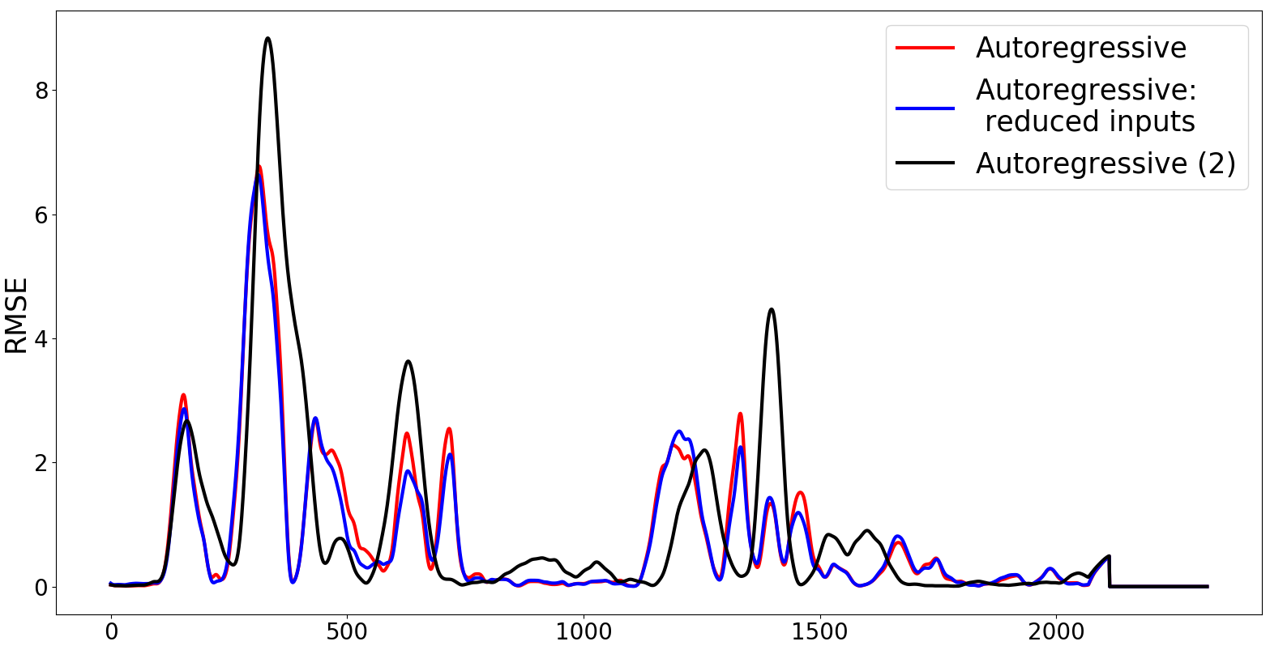
Autoregressive approach (2): Preliminary results, the current results have not been verified

Slide 12

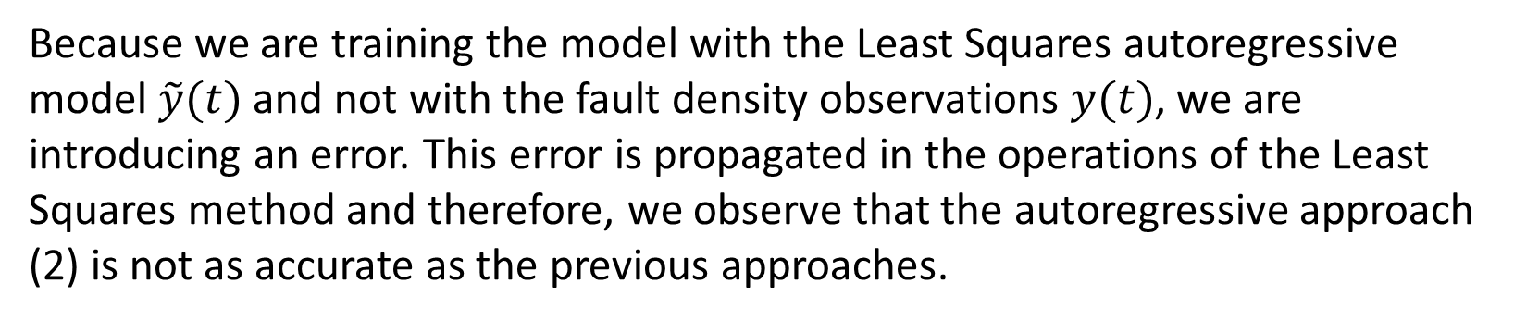
Autoregressive approach (2):
$$f\left(x\right)≈\tilde{y}=θ^{T}x_{t}$$
Because we are training the model with the Least Squares autoregressive model $\tilde{y}(t)$ and not with the fault density observations $y(t)$, we are introducing an error. This error is propagated in the operations of the Least Squares method and therefore, we observe that the autoregressive approach (2) is not as accurate as the previous approaches.

Slide 13
List of activities
Ongoing work looking at filtering of inputs.
To run the autoregressive approach 1 with inputs removed.
To run the autoregressive approach 2 (but requires verification)
Re-run randomly selected inputs, focusing on 2nd half of data.
Better visualisation of effect of inputs on model output.

Slide 14
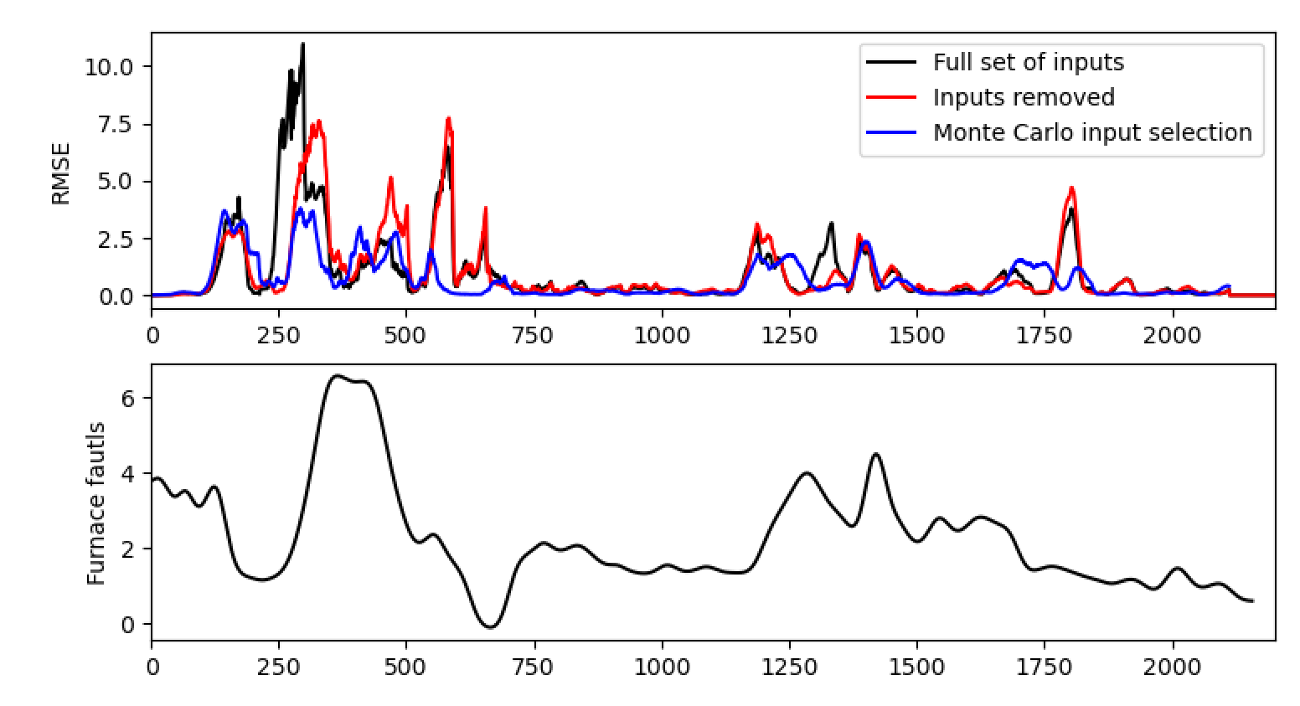
Results from last week: Where the inputs were still a little bit “noisy”

Slide 15
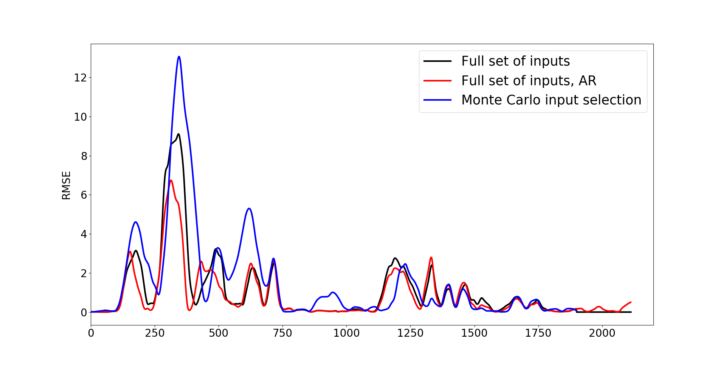
Randomly selecting the best inputs
5000 Monte Carlo simulations were run
Optimising performance after the 1000 point mark
The second region shows better results but the difference is marginal
Amount of filtering also appears to influence the parameters that are retained but doesn’t seem to positively influence model performance.

Slide 16
List of activities
Ongoing work looking at filtering of inputs.
To run the autoregressive approach 1 with inputs removed.
To run the autoregressive approach 2 (but requires verification)
Re-run randomly selected inputs, focusing on 2nd half of data.
Better visualisation of effect of inputs on model output.

Slide 17
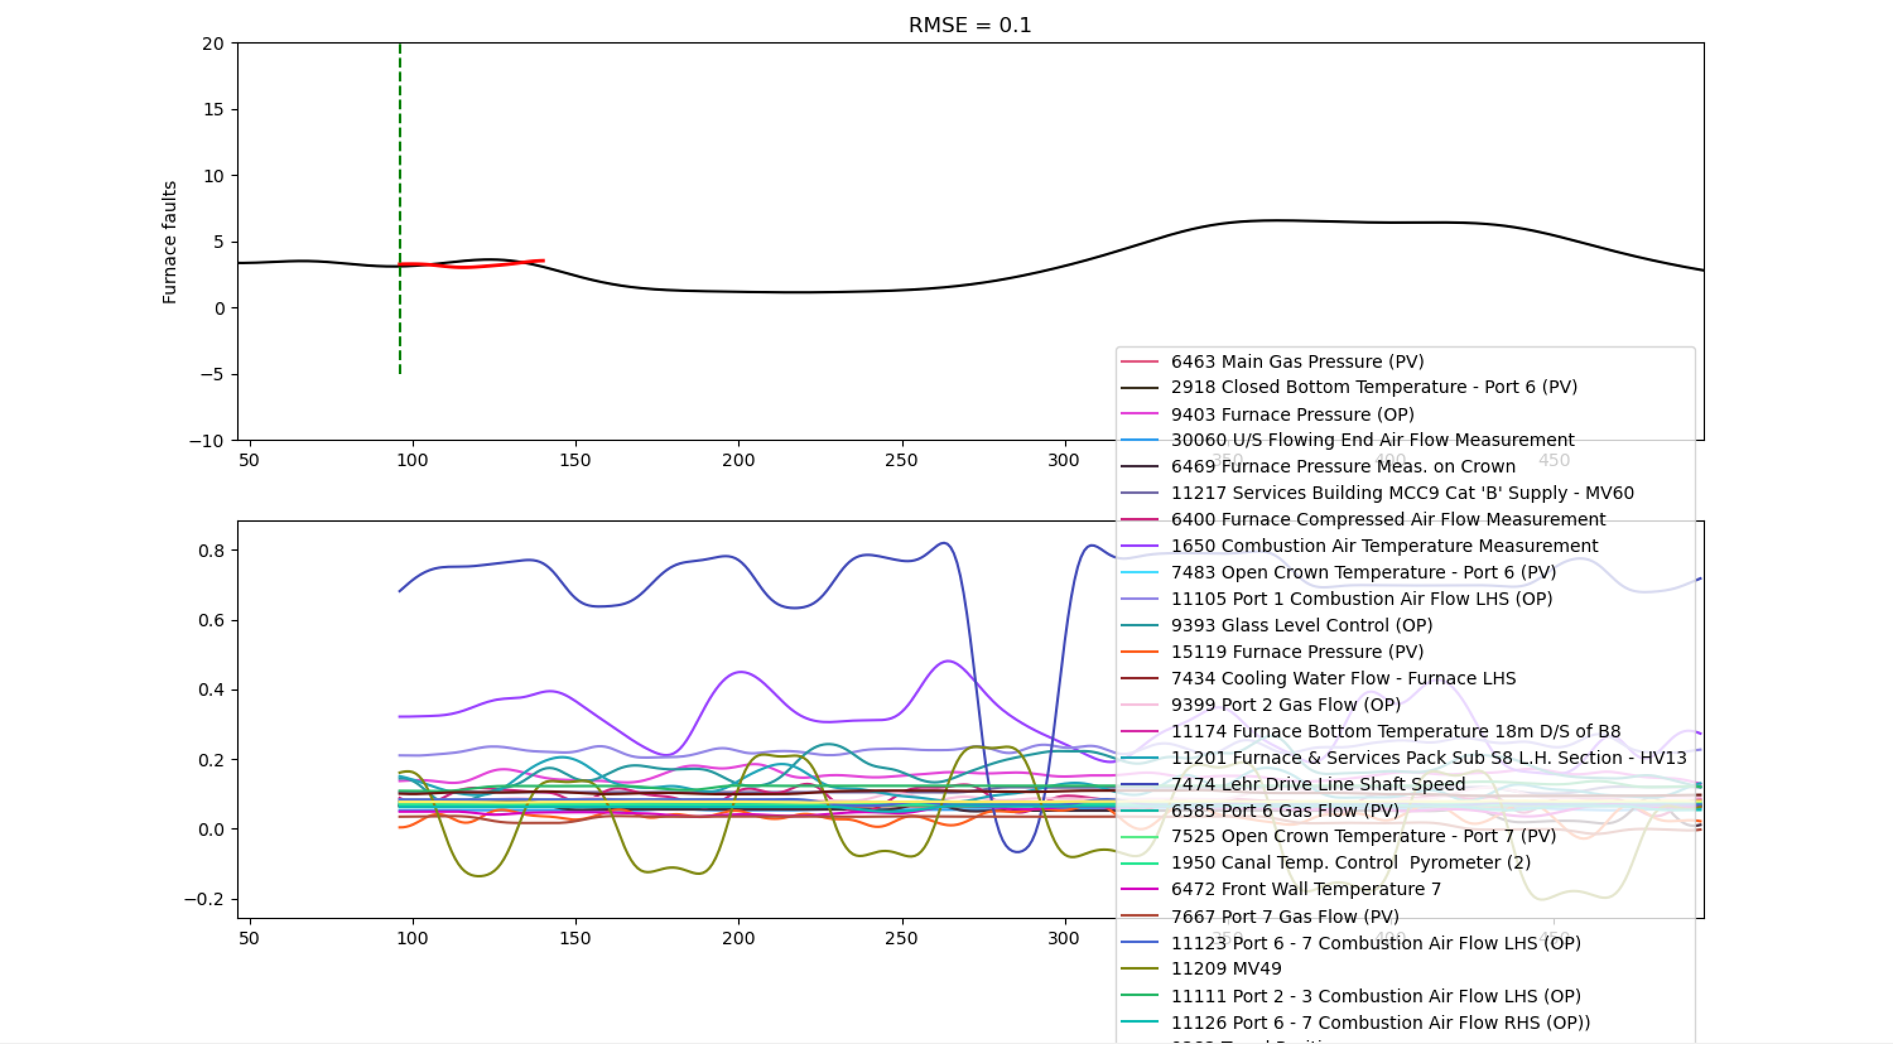
Visualisation

Slide 18
List of activities
Ongoing work looking at filtering of inputs.
To run the autoregressive approach 1 with inputs removed.
To run the autoregressive approach 2 (but requires verification)
Re-run randomly selected inputs, focusing on 2nd half of data.
Better visualisation of effect of inputs on model output.

Slide 19
Conclusions
We may have taken linear models as far as they can go.
But input from NSG regarding suitable inputs may be improve things.
Filtering perhaps not as important as we thought?
Key next steps will be:
Introduction of nonlinear structures.
Preparation of validation data.

Slide 20
Next Steps
AR model (2) verification
Filtering (still ongoing)
Apply nonlinear model structures
Prepare validation data

Slide 21
Thank you for your attention. ANY QUESTIONS?

